Slide 1
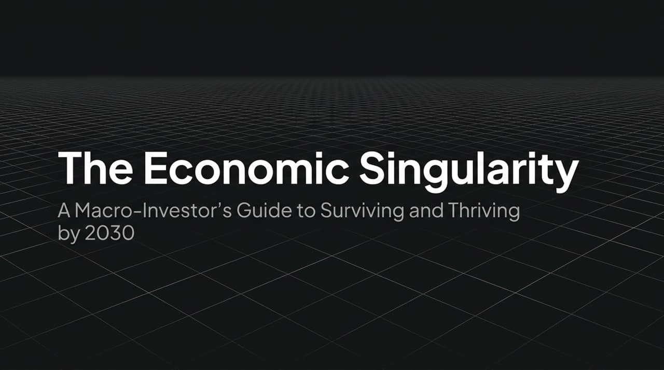
Notes:
Welcome, everyone. Today we are stepping outside the traditional macro model to address what I call 'The Economic Singularity'—a shift that will redefine global markets by 2030. We are rapidly approaching a reality where GDP growth isn't hovering at a standard 2-3%, but accelerating up to 20% due to non-human productivity. Ask yourselves: how do current valuation models function when we place Artificial General Intelligence into a physical, autonomous robot? Who captures that value? The catalyst driving this is a double-exponential technology wave colliding head-on with the largest sovereign debt bubble in human history. Over the next few minutes, we will map out how this intersection creates both immense structural risk and the greatest wealth-creation opportunity of our lifetimes.
https://www.youtube.com/watch?v=LzoyaoYKUns

Slide 2
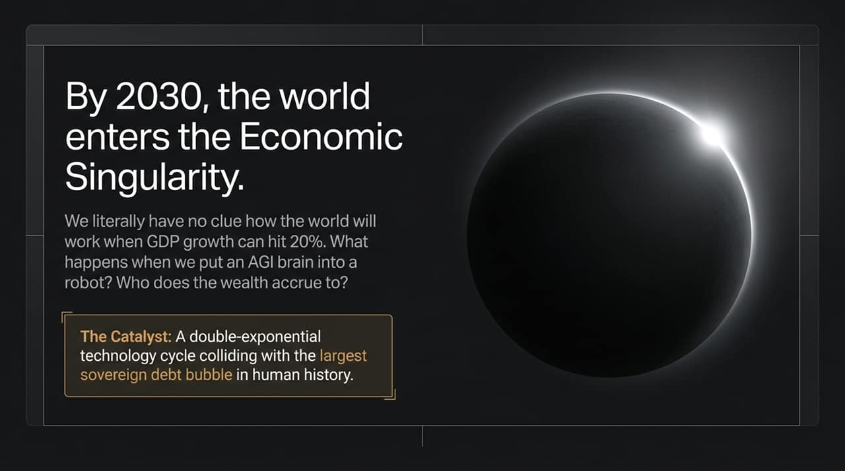
Notes:
To understand why this shift is inevitable, let's look at classic macroeconomic theory: GDP growth is simply Population Growth plus Productivity Growth plus Debt Growth. For decades, developed economies pulled the debt lever to engineer growth, but we are now at the absolute mathematical limit. Governments cannot endlessly borrow without devaluing currency to zero. Concurrently, demographic trends are catastrophic. Labor force participation is collapsing, and human populations are actively shrinking across the top producing nations. That leaves only one variable left in the equation that can scale infinitely: Productivity. AI and synthetic human labor are not just shiny new technologies; mathematically, they are the sole remaining savior to prevent total sovereign economic collapse.

Slide 3
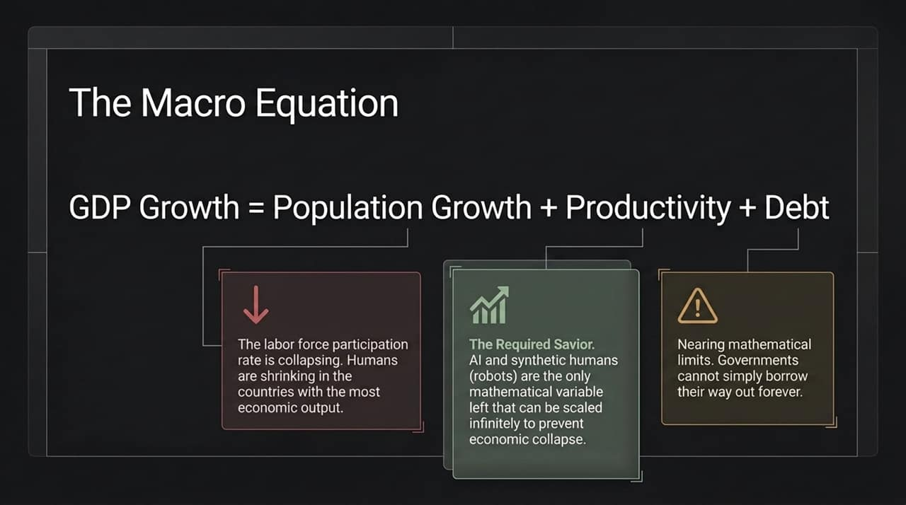
Notes:
This brings us to the self-reinforcing flywheel driving global liquidity today. First, the geopolitical stakes: the race for AI dominance between the US and China is a nation-state existential battle. Neither side can afford to lose. Second, hyperscalers require the largest infrastructure and compute capex buildout in human history. But governments are broke; they can't fund this directly. So, central banks step in, altering banking regulations and loosening capital requirements to force commercial banks into supplying endless liquidity. The takeaway for investors is clear: the money printer will not stop. Central banks will print to service legacy sovereign debt, and they will print to win the AI arms race.

Slide 4
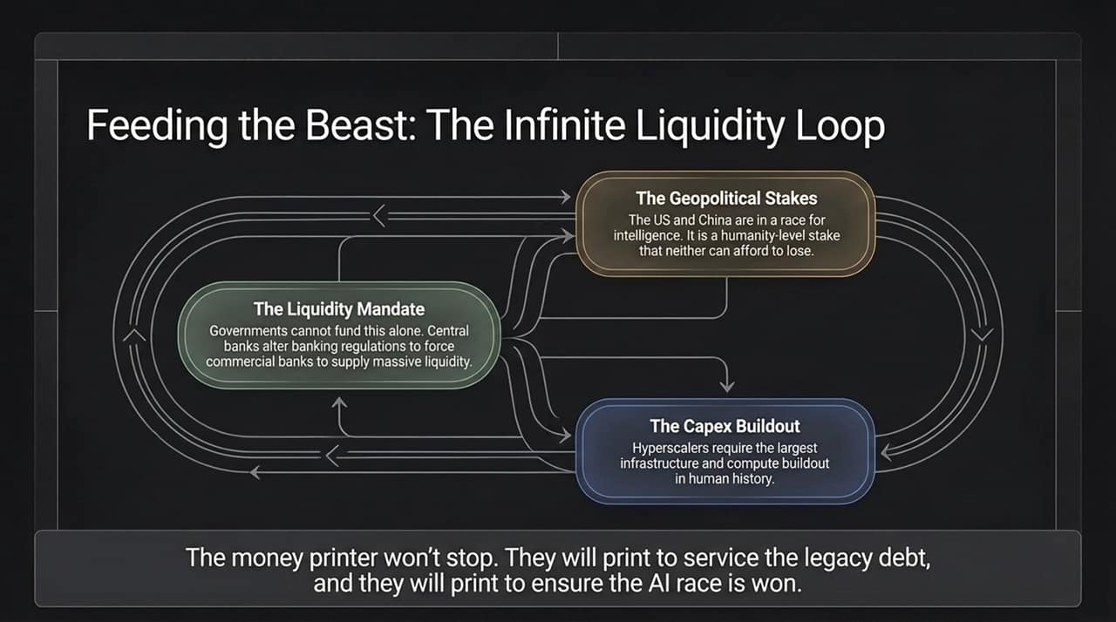
Notes:
This perpetual liquidity engine exacerbates a brutal K-shaped divide. On the upper arm, you have the Accelerationists—asset holders owning tech equities, crypto, and prime real estate who absorb this massive debasement. Their wealth compounds exponentially. On the lower arm are the Decelerationists—wage earners selling finite time, watching their purchasing power actively destroyed to subsidize the financial system. Policymakers face a grim choice: allow an 80% market crash that bankrupts the pension system, or engineer an 8% annual currency debasement that quietly taxes the populace. Every politician and central banker will choose the 8% debasement every single time.

Slide 5
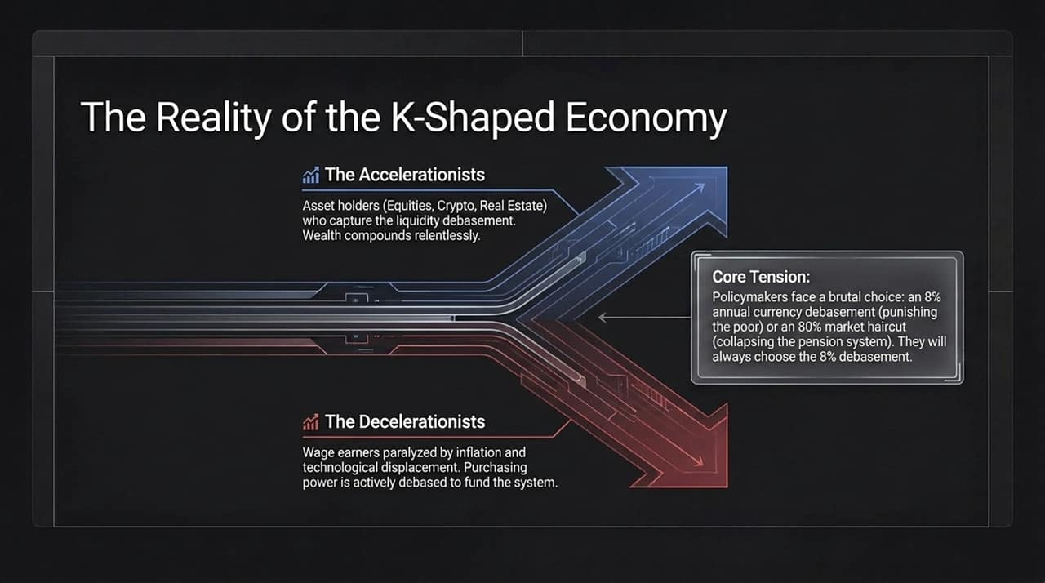
Notes:
Let's examine why this technological shift is fundamental. Up until now, economic output relied on carbon-based intelligence—human brains. That model is constrained by slow biological evolution and finite human time. It scales linearly or via Metcalfe’s Law, where network value scales relative to users. We are transitioning to silicon-based intelligence: running electricity through sand. Silicon computes millions of times faster than biology. Demand for intelligence is infinite due to Jevons Paradox—the cheaper and more abundant it becomes, the more we consume. Crucially, silicon networks follow Reed’s Law, producing double-exponential network effects. We are scaling intelligence itself, not just human connections.

Slide 6
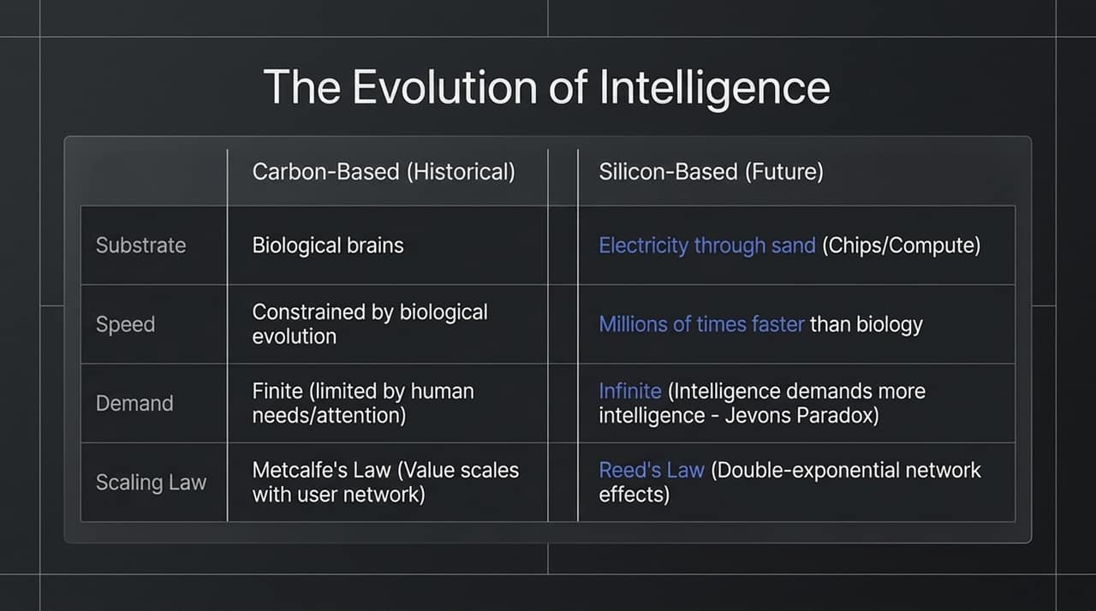
Notes:
Because AI operates on a silicon substrate and compounds on itself, its adoption curve breaks human intuition. The internet took decades to achieve global scale. Crypto accelerated that curve significantly via open financial rails. But look at AI: OpenAI reached 100 million users in a matter of weeks. AI is a total compression of every piece of digitized human knowledge, processed instantaneously. When you stack Reed’s Law on top of software distribution, adoption happens at a speed human brains are psychologically unequipped to process. This rapid adoption compresses multi-decade economic shifts into a multi-year window.

Slide 7
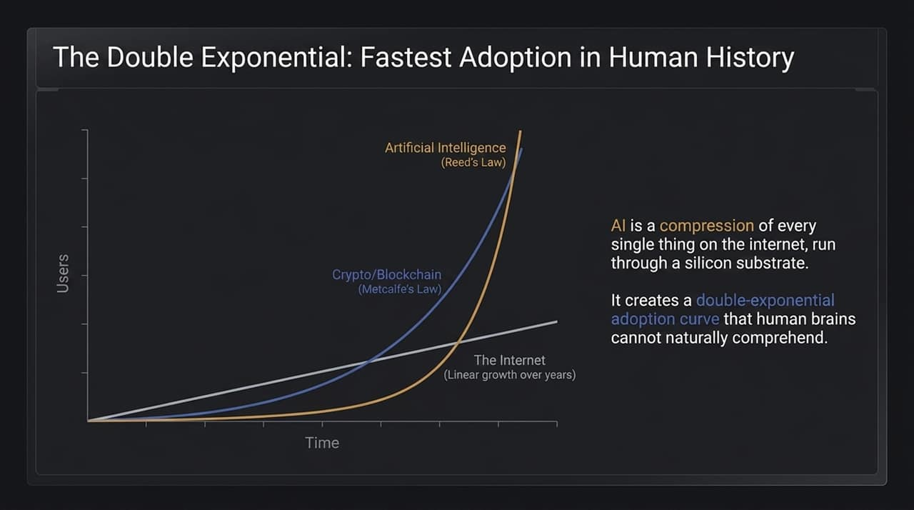
Notes:
Many macro commentators argue that current AI capex is a repeat of the 2000 Dot-Com crash. That comparison is completely flawed. In 2000, telecom companies carried massive balance-sheet leverage with zero cash flow, building fiber networks for demand that didn't yet exist. Today's hyperscalers—Microsoft, Google, Meta, Amazon—are the most profitable cash-flow generation engines in human history. They carry less than 4% debt relative to their market caps. They aren't burning borrowed cash speculatively; they are reinvesting organic cash flow to acquire the compute required to survive. This isn't a bubble; it is strategic corporate defense.

Slide 8
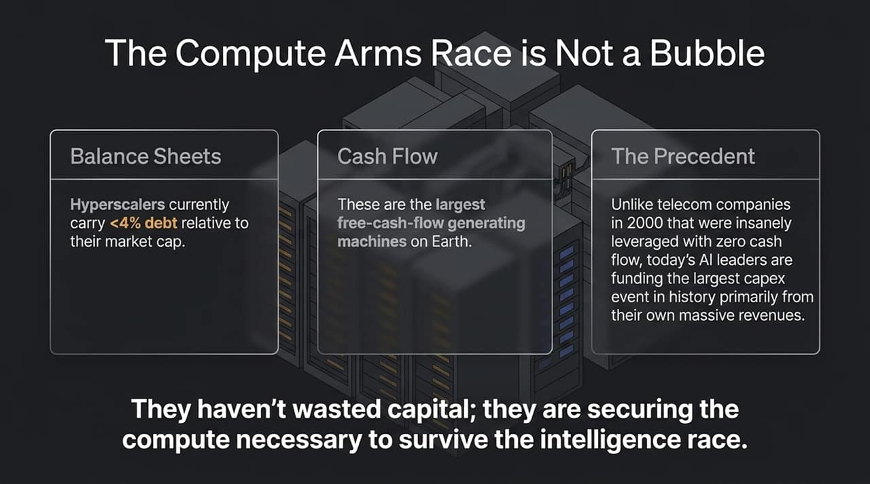
Notes:
How does money flow in a world run by autonomous software? In the Agentic Economy, an AI agent receives a prompt and autonomously buys API calls, compute, or digital services. But AI agents cannot open traditional bank accounts, complete KYC processes, or wait three business days for ACH clearing. They require instant, 24/7 programmable settlement. This is where stablecoins and public blockchain rails become essential. Stablecoins are the native currency of silicon intelligence. Blockchains provide the permissionless, high-velocity financial architecture required for billions of machine-to-machine microtransactions to settle instantly.

Slide 9
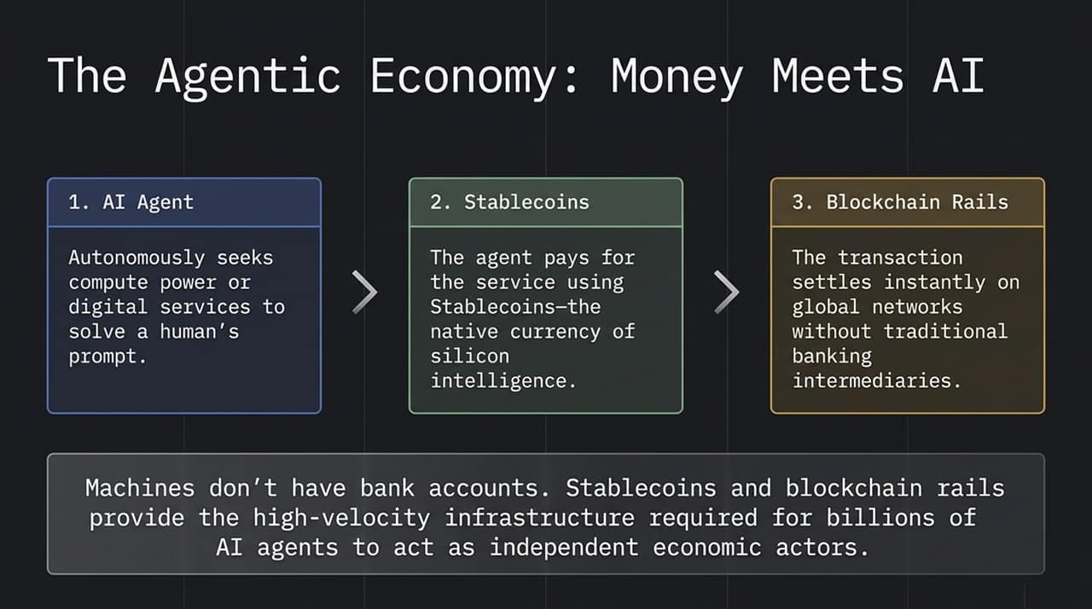
Notes:
How do global economies resolve historic debt-to-GDP levels without outright default? They don't pay it back; they outgrow it. This chart illustrates the classic post-WWII financial repression model, supercharged by AI. After World War II, nations inflated nominal GDP while capping interest rates, inflating away the debt's relative size. By integrating AI agents and automation to drive productivity growth toward 10–20%, the compound denominator—GDP—expands far faster than the numerator—debt. Nominal debt shrinks rapidly as a percentage of total economic output. This financial repression is how sovereigns plan to survive.

Slide 10
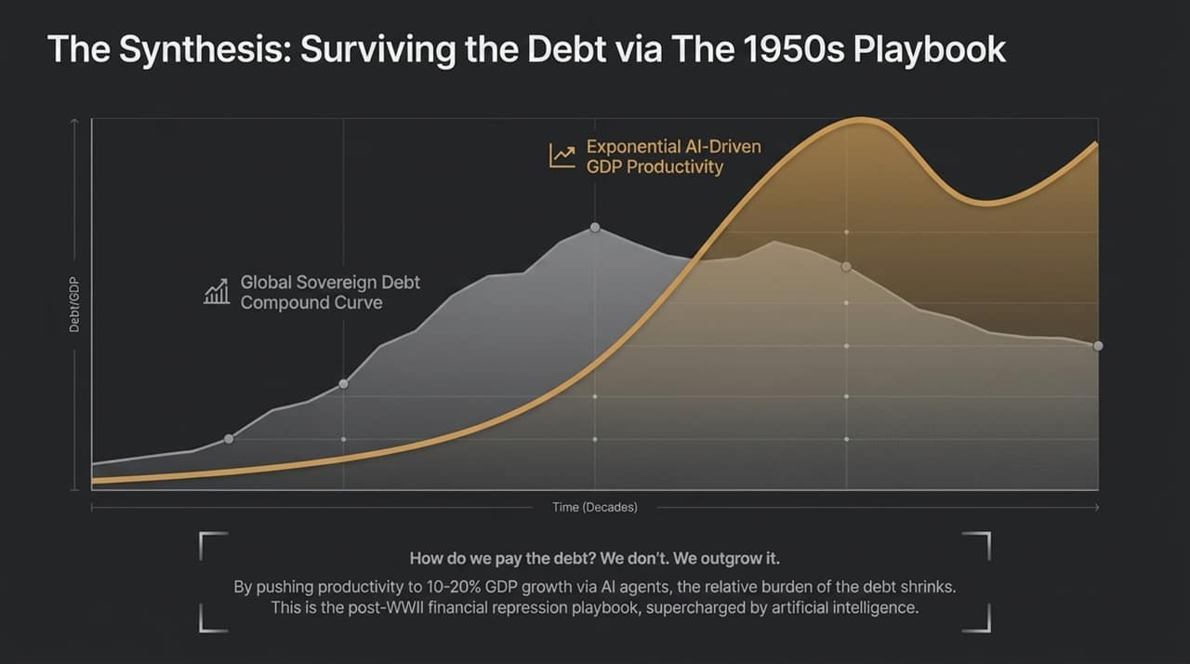
Notes:
If you want a blueprint for how this works in practice, look at Amazon. For years, Amazon’s human headcount grew linearly with order volume. Today, robotics, AI logistics, and autonomous systems are decoupling output from human labor. Amazon is rapidly approaching a 1:1 ratio of robots to human workers. The commercial result is massive productivity expansion and rising operating margins without scaling human overhead. Amazon is not an outlier; it is the early prototype for every Fortune 500 company over the next five years.

Slide 11
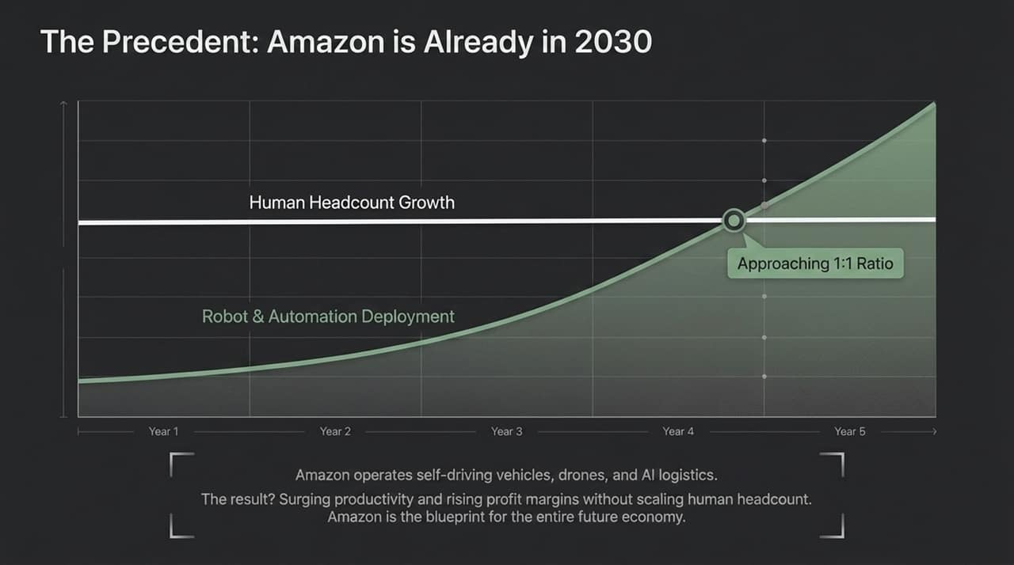
Notes:
Navigating this transition requires managing psychological biases. Market participants generally fall into two camps. The 'Doomer' or gold bug focuses exclusively on monetary debasement and geopolitical risk. By betting on systemic failure, they miss the largest tech-driven wealth creation cycle in history. Conversely, the 'Pragmatic Optimist' recognizes secular technological deflation and absolute abundance. They view fiat currency debasement as a known variable, holding cash reserves simply to buy market panics while riding double-exponential technology curves to compound generational wealth.

Slide 12
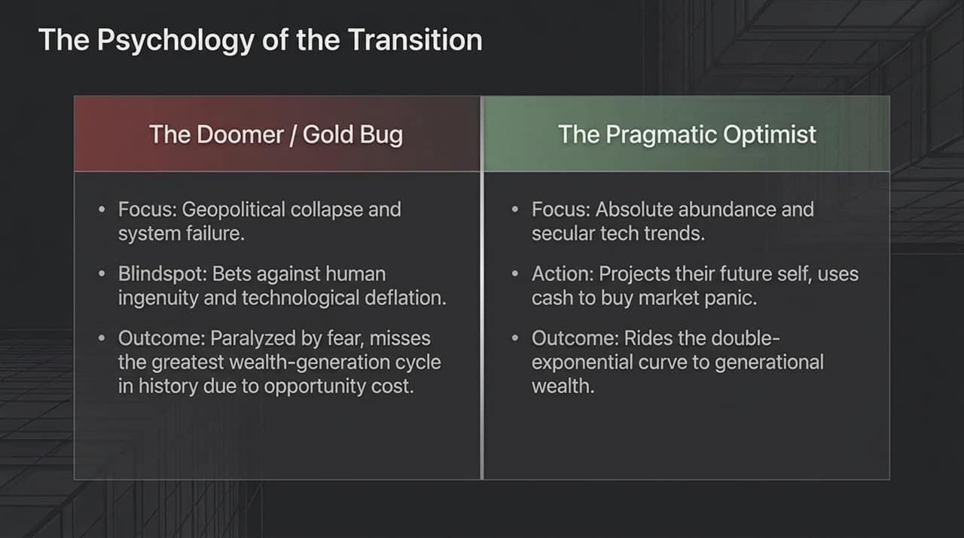
Notes:
In a double-exponential asset class, volatility is structurally unavoidable. A 50% drawdown in assets like tech equities or Bitcoin is not a failure of the investment thesis; it is a feature of long-term adoption curves. If you project short-term fear onto these drawdowns, you will panic and liquidate near the bottom. But if you anchor your portfolio strategy to a secular technological trend extending out to 2030, a 50% correction is simply a temporary discount. Follow Warren Buffett’s playbook: remain structured so you never have to sell, and keep dry powder to buy panic.

Slide 13
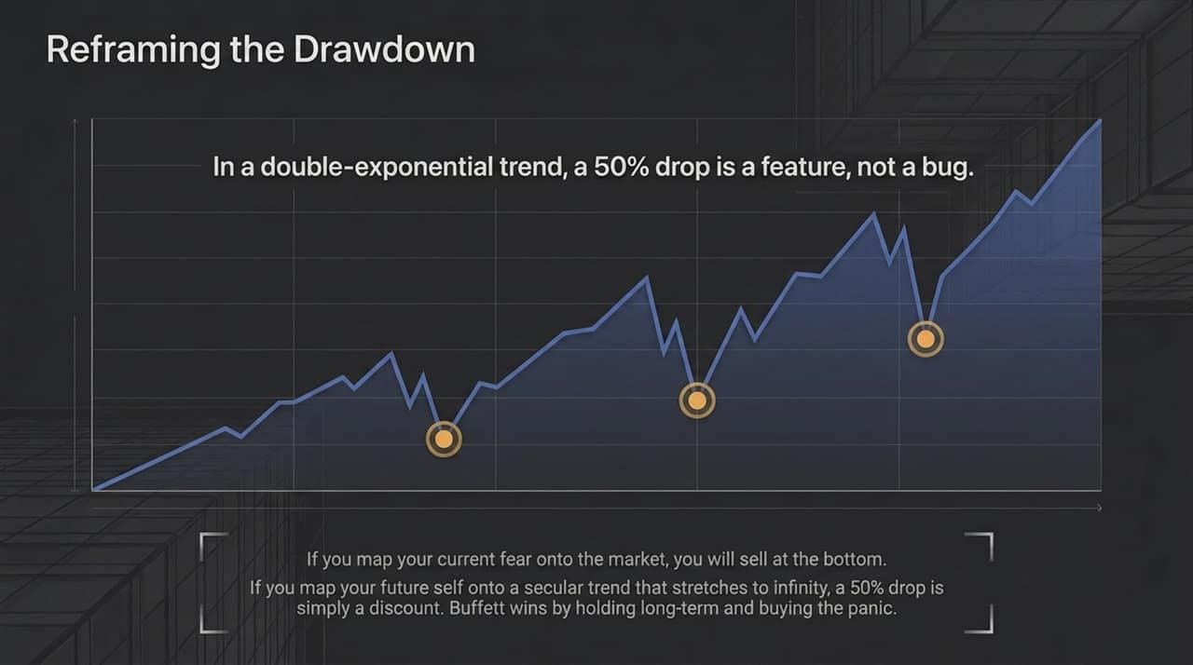
Notes:
Here is the actionable framework for individual investors. First: Own the secular trend outright. Allocate to broad tech via the NASDAQ, digital scarcity via Bitcoin, and core execution layers like Solana. Second: Maintain cash reserves. Keep dry powder in short-duration T-bills so that when 50% drawdowns occur, you have liquidity to buy without emotional stress. Third: Zero leverage. Never use margin to buy volatile assets. Without debt, you eliminate liquidation risk, allowing you to hold through volatility while the broader market panics.

Slide 14
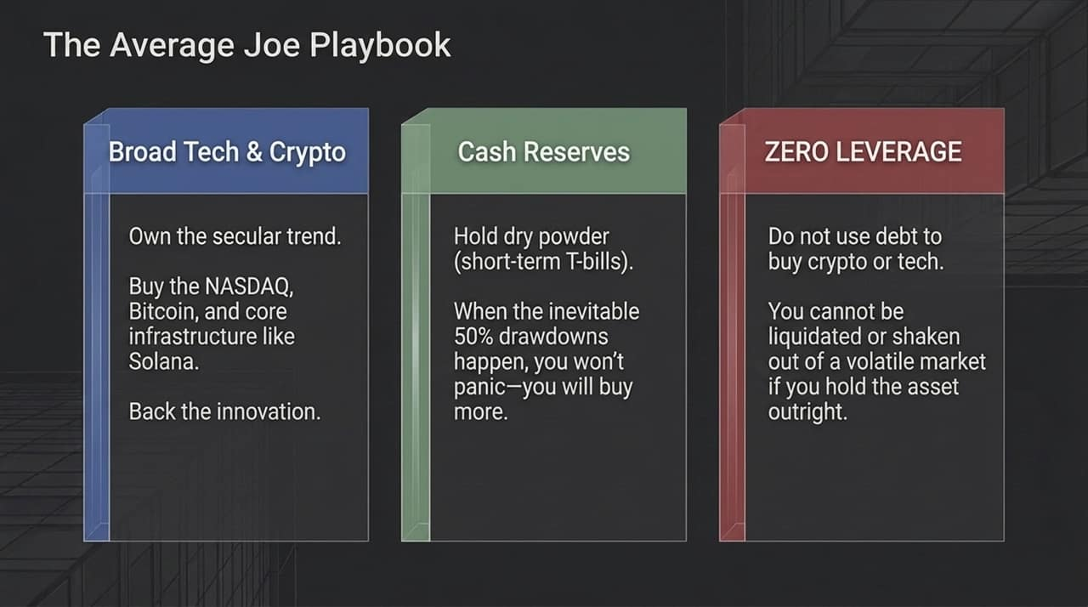
Notes:
To survive this shift, you must reframe your relationship with technological disruption. Don't fight automation out of fear; hedge against it by owning the infrastructure driving it. At a physics level, economic progress optimizes for intelligence output per unit of energy expended. Capital naturally flows toward maximum efficiency. By putting electricity through sand, we are creating infinite scaling intelligence. Lean directly into this structural shift, capture the upside, and align your assets with where capital is inevitably flowing.

Slide 15
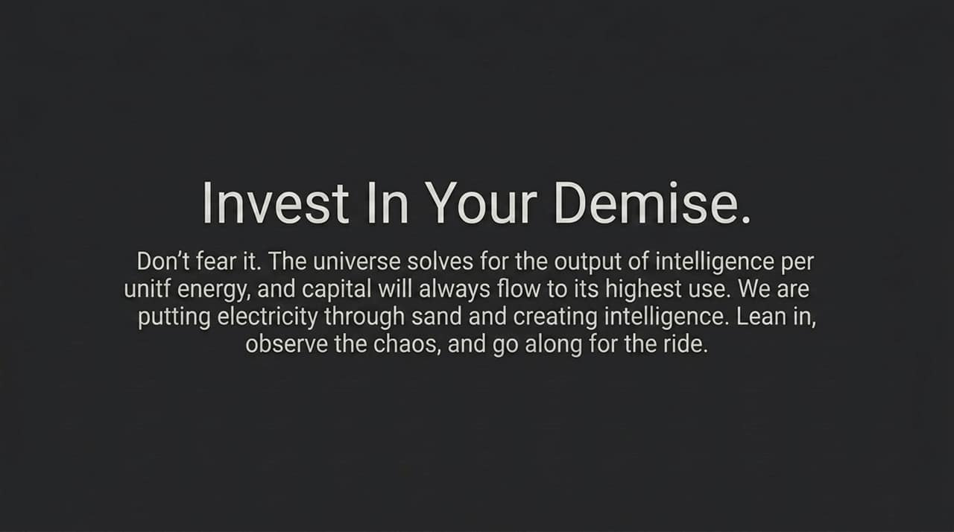
Notes:
Let's summarize the macro positioning framework as we look toward 2030. The exponential engine of AI compounds information on silicon substrates, driving rapid adoption. Simultaneously, AI agents and robotics offer a path toward 10–20% potential GDP growth. Central banks will continue debasing fiat currencies to manage legacy debt burdens. To protect your capital: Own assets over liabilities. Own corporate equity and technology platforms rather than long-term government bonds, which act as uncompensated liabilities during currency debasement. Size your positions appropriately so you can hold through market pullbacks comfortably.

Slide 16
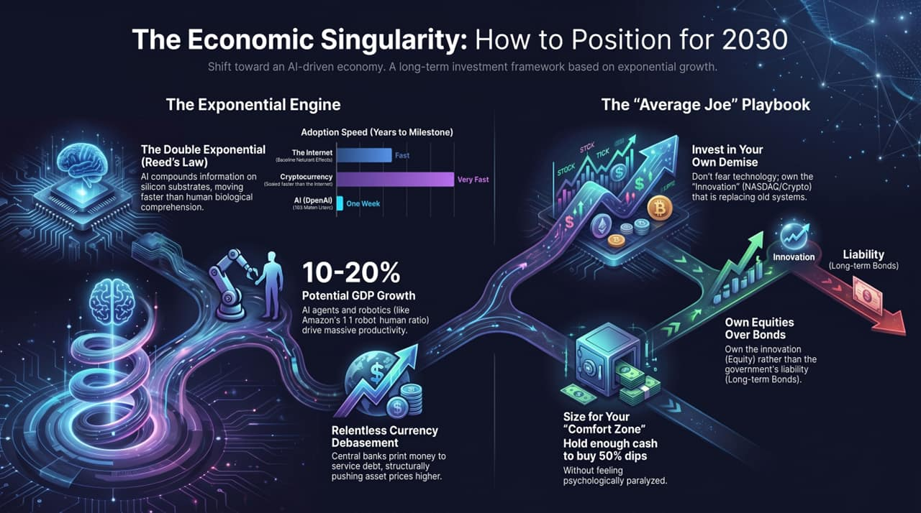
Notes:
To conclude, the path forward requires operational discipline. Avoid over-analyzing short-term headlines and focus on the structural trend. Maintain balance by holding growth assets alongside short-term cash yields, ensuring you aren't forced to sell during volatility. The world is moving from carbon-based linear growth to silicon-based double-exponential expansion. By understanding these macro forces, managing risk without leverage, and owning core technology rails, you can transition from being vulnerable to technological disruption to actively benefiting from the Economic Singularity. Thank you.

